Slide 1
Docker
Playing around with a examples
02/28/2020

Slide 2
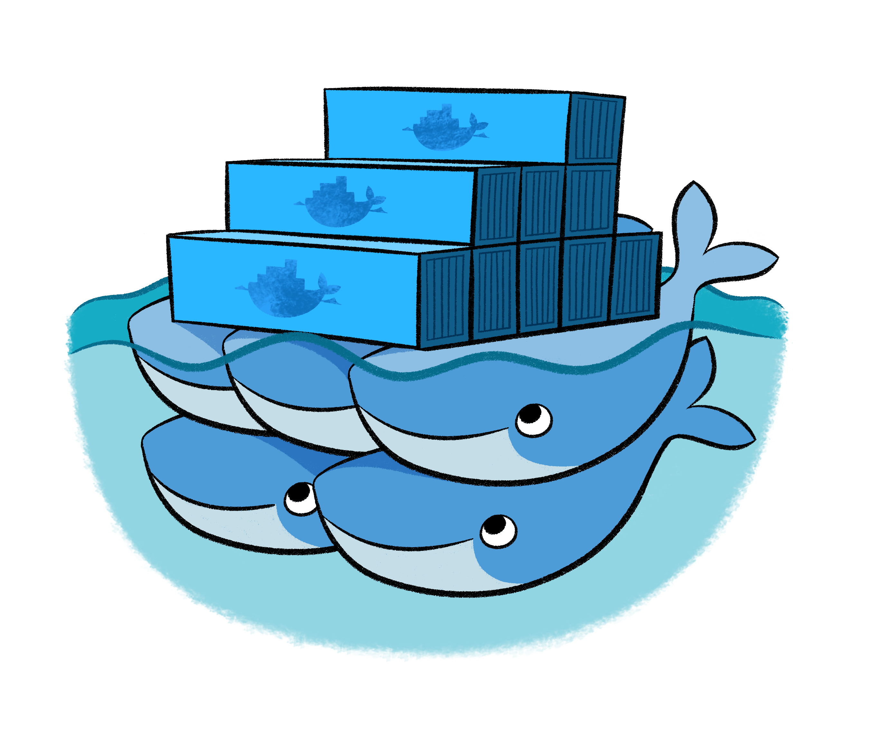
On this session…
Creating some useful services
Prerrequisites
What’s an overlay network?
Creating an overlay network
Creating the services
Setting up a PSQL service
Setting up a Drupal service
Services up and running!

Slide 3

Prerrequisites for creating services
Understanging about Docker Network operations
Knowledge about Docker Swarm
docker-machine of Docker Desktop is a must!
A Docker Swarm cluster with three nodes

Slide 4

What’s an overlay network?
The overlay network driver creates a distributed network among multiple Docker daemon hosts. This network sits on top of (overlays) the host-specific networks, allowing containers connected to it (including swarm service containers) to communicate securely when encryption is enabled. Docker transparently handles routing of each packet to and from the correct Docker daemon host and the correct destination container.
When you initialize a swarm or join a Docker host to an existing swarm, two new networks are created on that Docker host:
An overlay network called ingress, which handles control and data traffic related to swarm services. When you create a swarm service and do not connect it to a user-defined overlay network, it connects to the ingress network by default.
A bridge network called docker_gwbridge, which connects the individual Docker daemon to the other daemons participating in the swarm.

Slide 5
What do you need to create an overlay network?
Firewall rules for Docker daemons using overlay networks
You need the following ports open to traffic to and from each Docker host participating on an overlay network:
TCP port 2377 for cluster management communications
TCP and UDP port 7946 for communication among nodes
UDP port 4789 for overlay network traffic
Before you can create an overlay network, you need to either initialize your Docker daemon as a swarm manager using docker swarm init or join it to an existing swarm using docker swarm join. Either of these creates the default ingress overlay network which is used by swarm services by default. You need to do this even if you never plan to use swarm services. Afterward, you can create additional user-defined overlay networks.

Slide 6
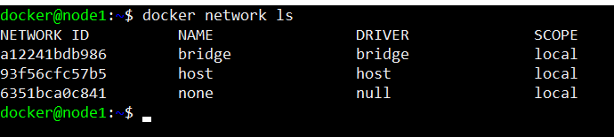
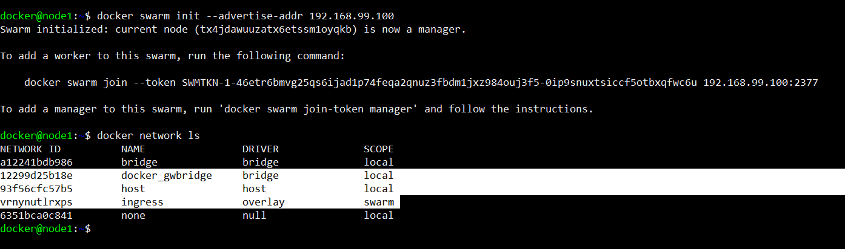
Let’s see how this works!
Before creating a Docker Swarm
After creating a Docker Swarm

Slide 7
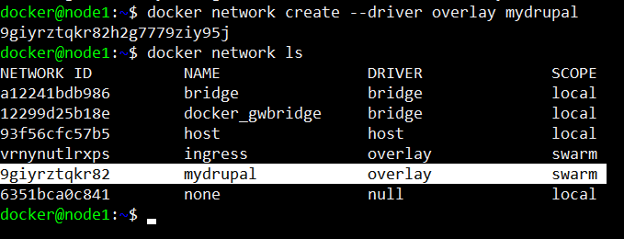
Creating a new overlay network

Slide 8
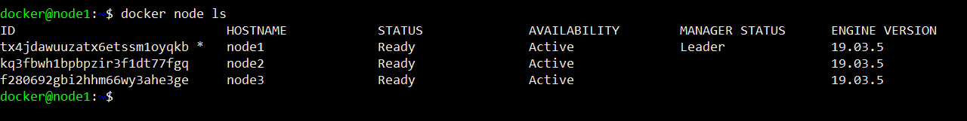
Do you have you Docker Swarm cluster already created?
You can do this by using the docker swarm init and the docker swarm join generated as response by executing that instruction
You Docker Swarm cluster must look like this:

Slide 9
Creating the services

Slide 10
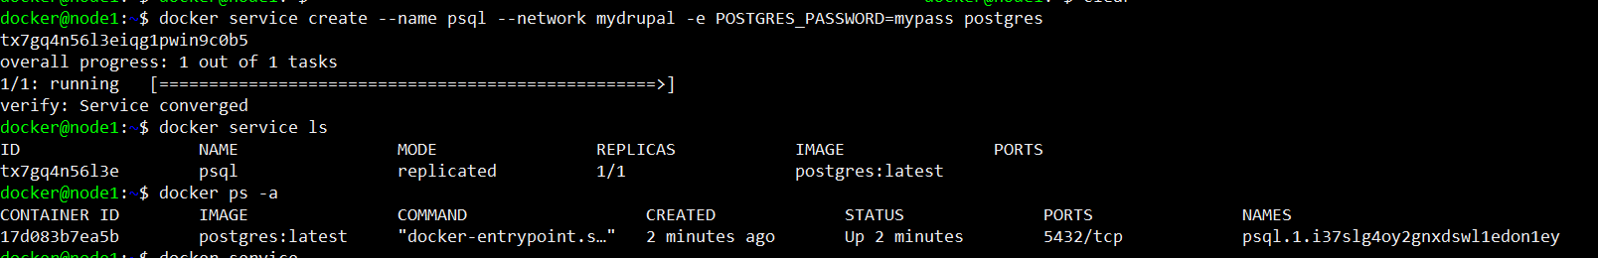
Setting up a PSQL service

Slide 11
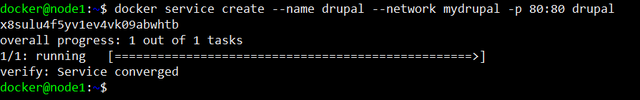
Setting up a Drupal service

Slide 12
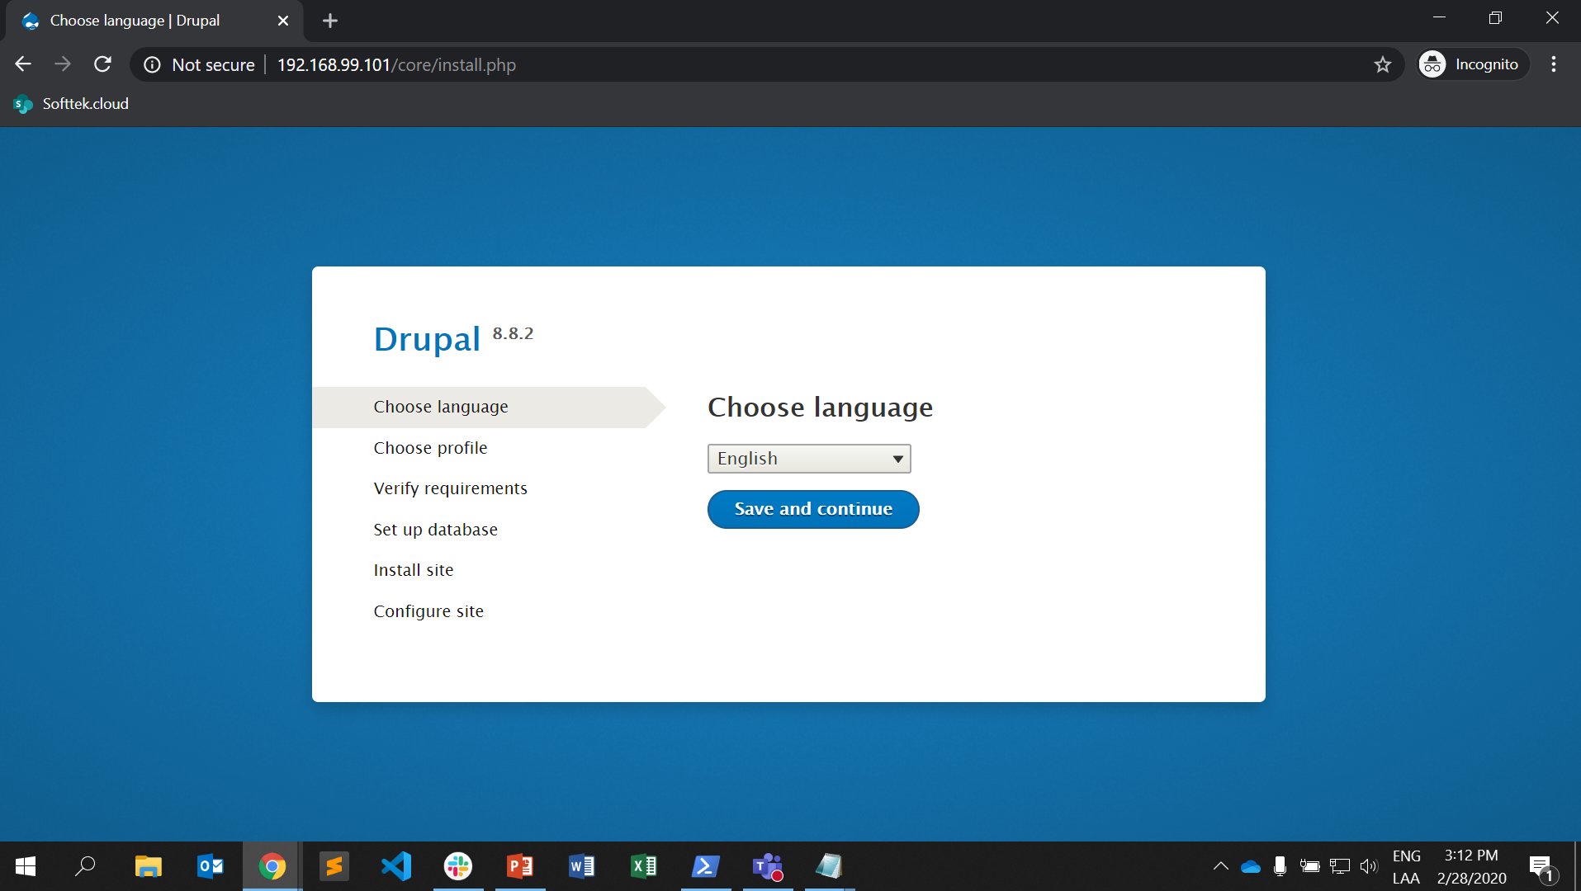
Now our services are running!

